Slide 1
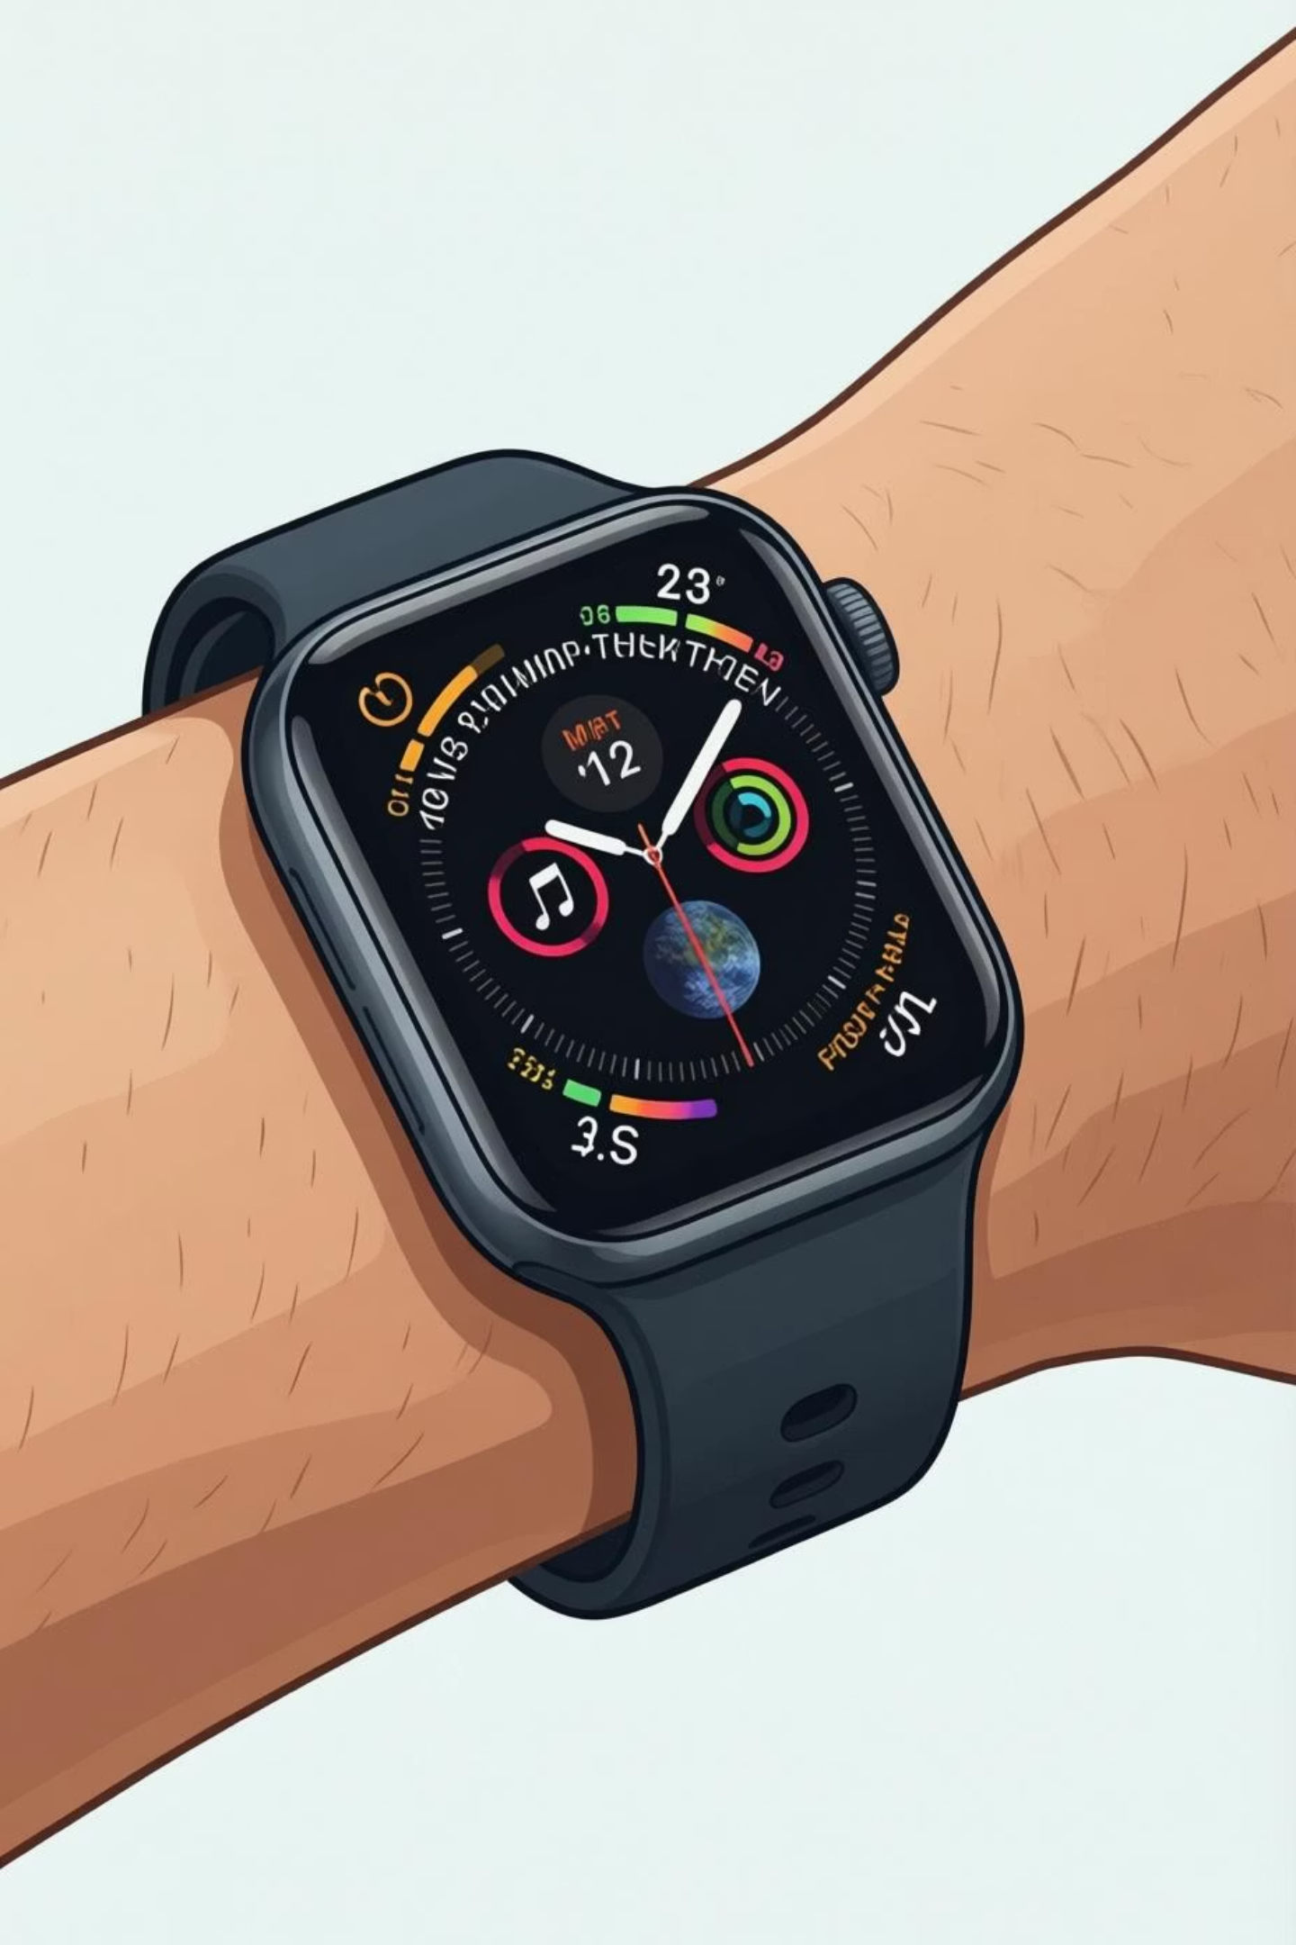
Exploratory Data Analysis on WeFit Fitness Tracker Dataset
A Comprehensive Study of Physical Activity, Heart Rate, Sleep Patterns, and Weight Trends Using Python

Slide 2

Project Objectives
Activity Patterns
Steps & Calories
Analyze daily physical activity levels and movement behaviors across diverse user segments
Study the relationship between daily steps taken and calories burned to understand energy expenditure
Vital Trends
User Classification
Analyze heart rate, sleep quality, and weight trends to identify health patterns and correlations
Classify users into activity levels (Beginner, Intermediate, Pro) based on comprehensive metrics

Slide 3
Dataset Overview
This project analyzed 7 datasets containing fitness tracker information from 33 users over 31 days, totaling approximately 2,900 records.
1
2
3
Daily Activity
Daily Steps
Daily Calories
Total steps, calories, distance, and active minutes tracked daily
Aggregated step counts recorded throughout each day
Calories burned tracked at minute-level intervals
4
5
6
Daily Intensities
Heart Rate
Sleep Day
Sedentary, lightly active, fairly active, and very active time periods
Heart rate measurements recorded in seconds throughout the day
Sleep duration, efficiency, and quality metrics
7
Weight Log
Weight measurements and BMI calculations

Slide 4

Tools & Methodology
Python Libraries
Pandas for data manipulation and analysis
NumPy for numerical computing
Matplotlib & Seaborn for visualization
Data Preprocessing
Handling missing values and duplicates
Converting date/time formats
Merging datasets using User ID and Date
Data type optimization and validation
EDA Techniques
Descriptive statistics and summary metrics
GroupBy analysis by user and time periods
Correlation analysis using Pearson coefficient
Distribution analysis with histograms and box plots

Slide 5
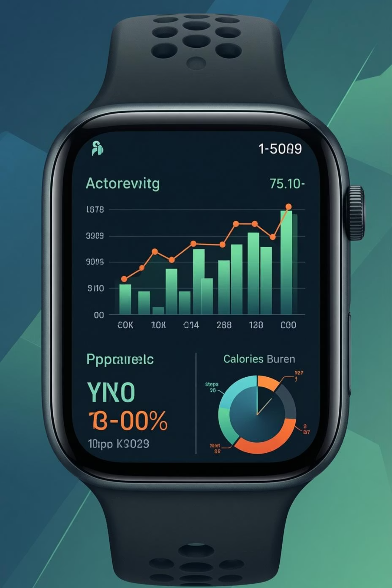
User Activity Classification
Beginner
Less than 5,000 daily steps, primarily sedentary lifestyle with minimal structured activity
Intermediate
5,000-10,000 daily steps, moderate activity with regular exercise routines
Pro
More than 10,000 daily steps, highly active lifestyle with consistent intense workouts
Classification based on established health guidelines from American Heart Association and CDC physical activity recommendations.

Slide 6
Key Findings
76%
42%
6.98
25.2
Lightly Active
Strong Correlation
Average Sleep (hrs)
Average BMI
Majority of users spent most time in light activity, suggesting need for more vigorous exercise
Positive correlation observed between daily steps and calories burned
Mean sleep duration across all users, with significant quality variation
Body Mass Index trend indicating overweight category for sample population

Slide 7
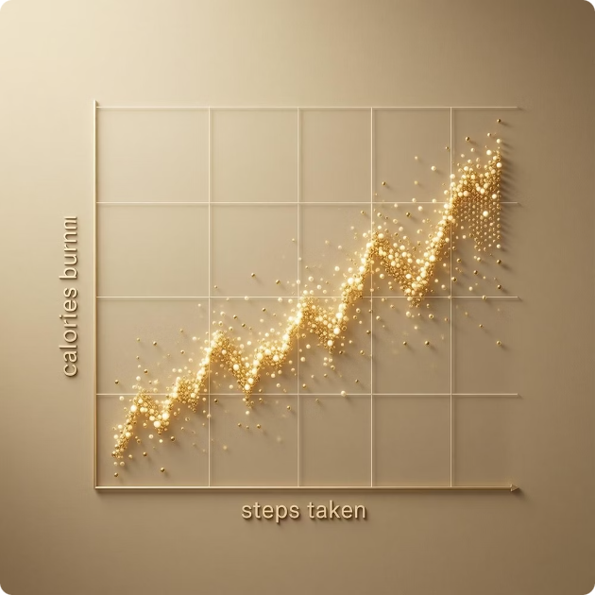
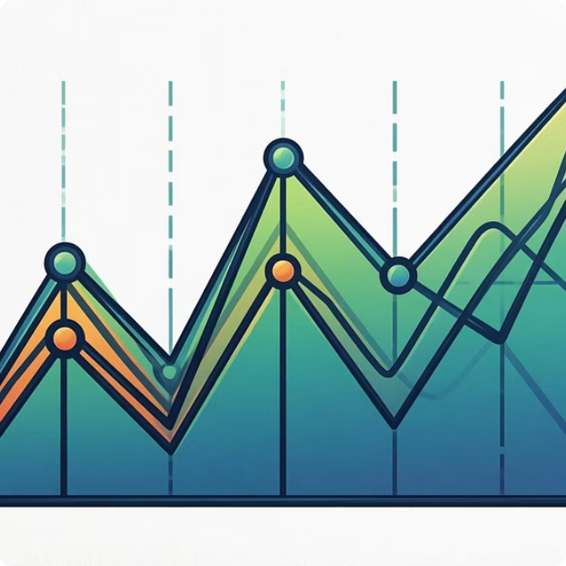
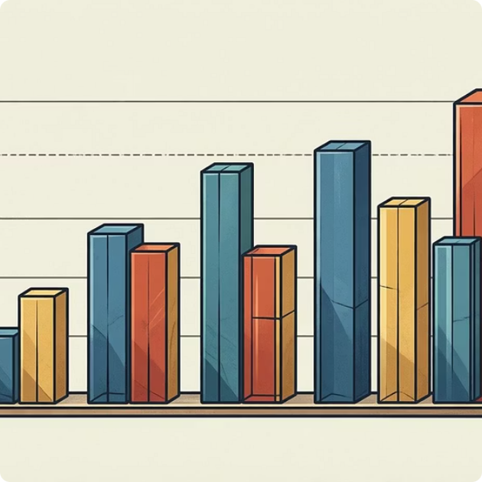
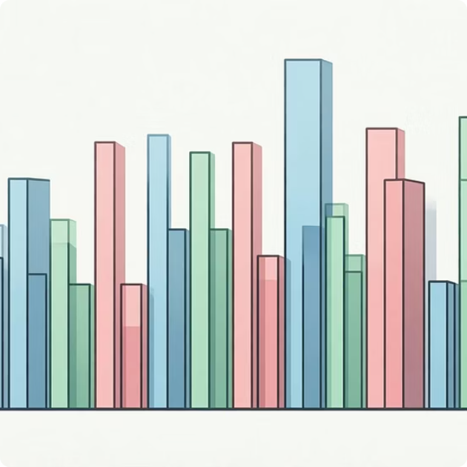
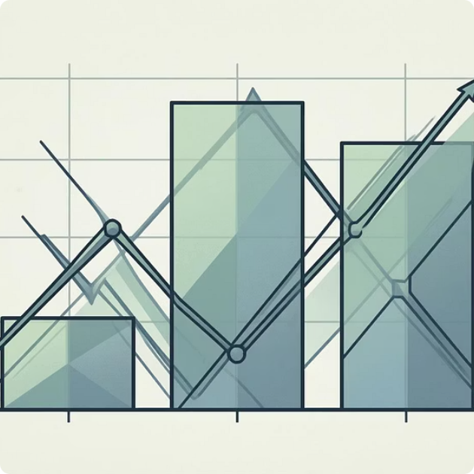

Data Visualization
Various chart types were employed to extract meaningful insights from the fitness tracker data.
Scatter Plots
Line Charts
Bar Charts
Histograms
Steps vs calories relationship analysis
Temporal trends in heart rate and activity
Comparative analysis across user groups
Distribution analysis of key metrics
Box Plots
Heatmaps
Outlier detection and spread visualization
Correlation matrices between variables

Slide 8

Conclusion & Future Scope
Project Summary
This EDA successfully characterized user fitness behaviors, identified activity patterns, and revealed correlations between physical activity metrics. The analysis demonstrated practical application of data science techniques in health analytics, providing actionable insights for fitness optimization.
Future Enhancements
Personalized Recommendations: AI-powered fitness suggestions based on individual patterns
Real-time Monitoring: Streaming data analysis for immediate feedback systems
Integration with Health APIs: Connect with medical records for comprehensive health profiles

Slide 9

Thank You
Additional Information
Project submitted for Data scientist at upGrad

